Slide 1
Predicting IMDB Rating of Upcoming Movies
Presented By:
Koshika Agrawal

Slide 2
Motivation for the project
Implement data science theory

Slide 3
Introduction
Problem Statement
I wish I could know the rating of this upcoming movie in advance!
Objective
To develop a model to predict IMDB rating of an upcoming movie using only data available prior to the release of the movie

Slide 4
Who cares? – The clients
Movie watchers
Movie Theatre Owners
Movie makers
I am definitely going to watch that movie coming up soon!
I would just like to run a movie rated above 6 in my theatre!
Can I have a model to get a perfect recipe for a hit movie?

Slide 5
Data Acquisition
Source:
https://www.imdb.com/interfaces/
Format:
5 datasets
gzipped, TSV formatted files
Null values represented by ‘\N’
Issues:
Redundant columns
Mixed datatypes
Addressed during data loading

Slide 6
Features of importance
Column | Type | Description
tconst | ‘tt‘ followed by 7 digits | unique identifier of the movie title
runtimeMinutes | number | movie length in minutes
genres | strings separated by commas | Eg: comedy, horror, romantic,
numVotes | number | number of user ratings given to a movie (post-release)
nconst | ‘nm‘ followed by 7 digits | key identifier for movie cast/crew
category | categorical | the category of job that person was in
averageRating | float | average of all the individual user ratings

Slide 7
Loaded Data
Data required:
title_akas (3.486.933, 4)
title_basics (5.642.968, 7)
title_principals (32.301.717, 3)
title_ratings (919.215, 3)
name_basics (9.139.818, 5)
Full-length feature film
Region – US
Release year – 1980/1999
Wrangled Dataset
Single dataset
titles_crew_pre(432.774,18)
Derived dataset
titles (49.440,7)

Slide 8
Exploratory Data Analysis

Slide 9
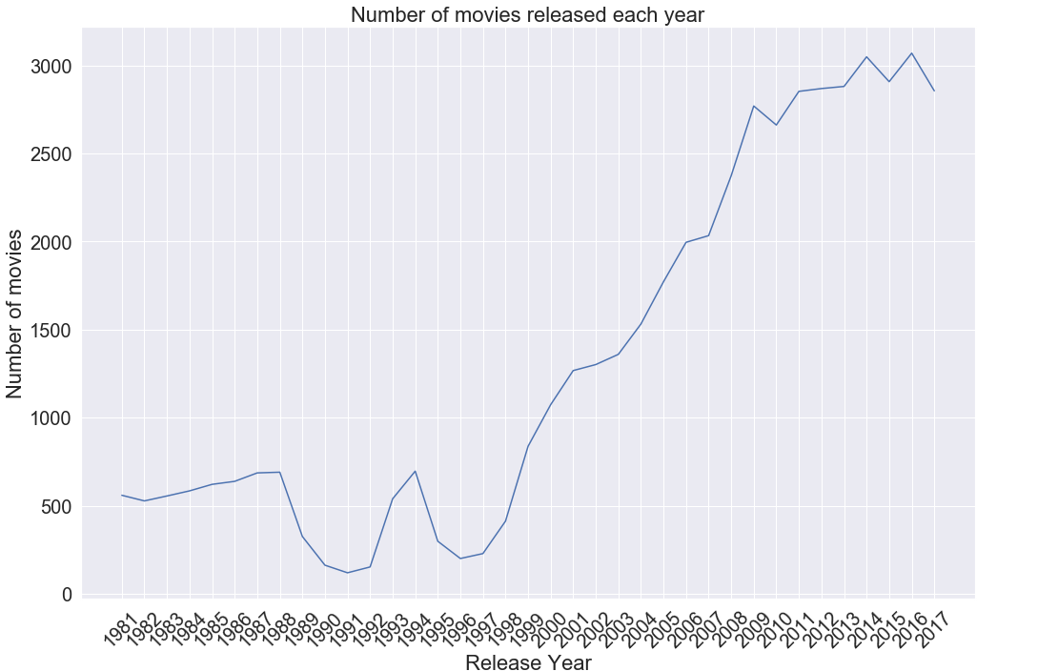
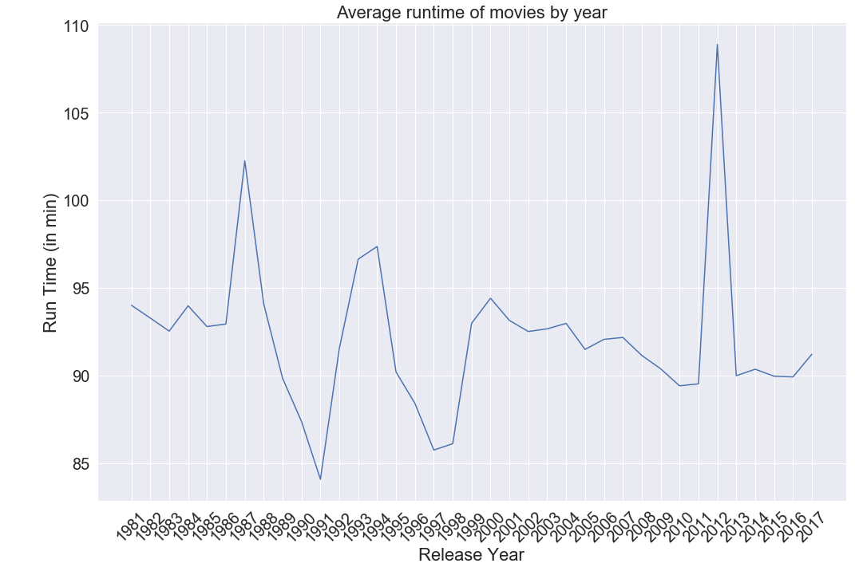
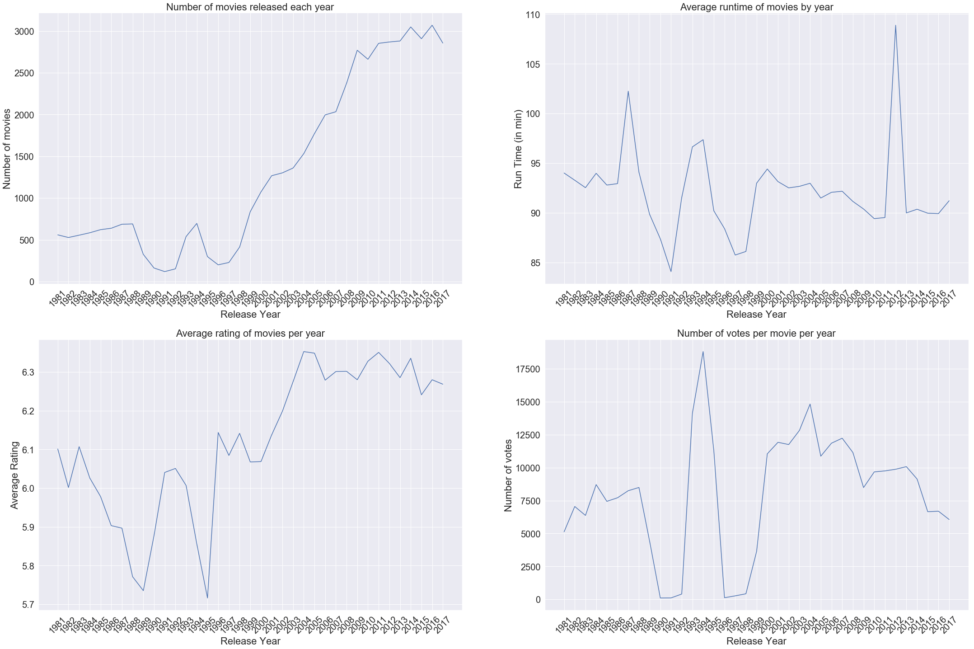
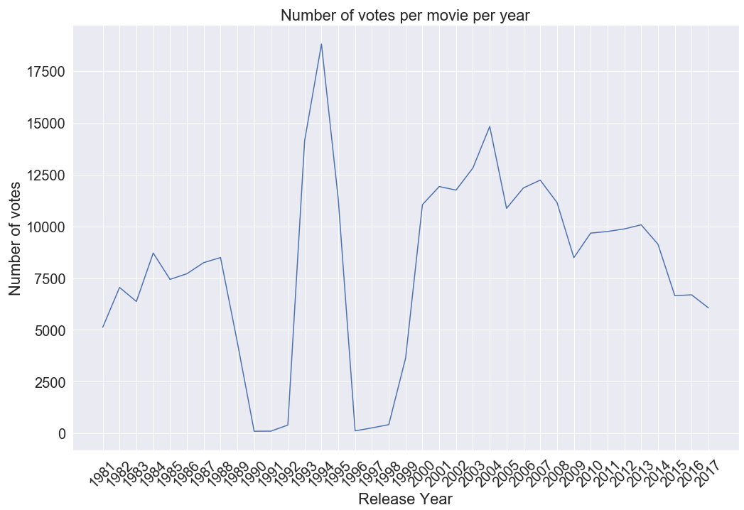
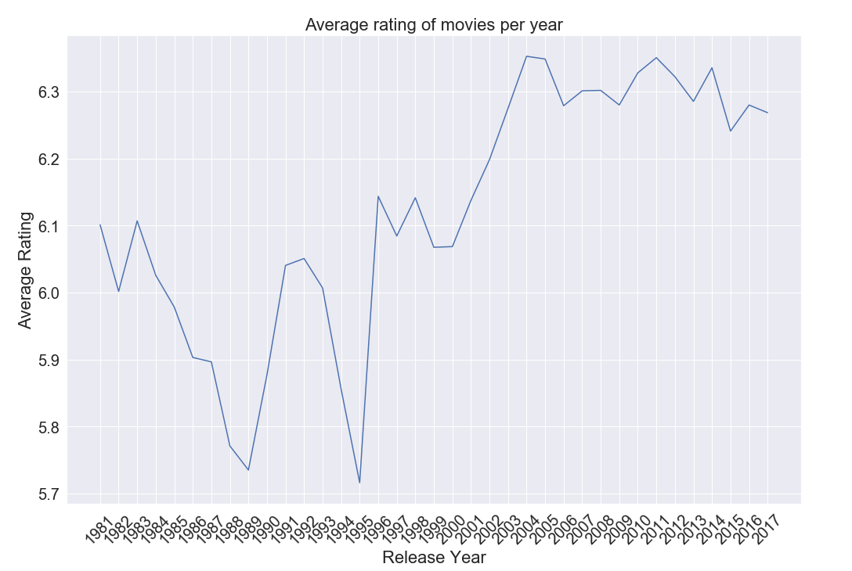
Yearly Trends

Slide 10
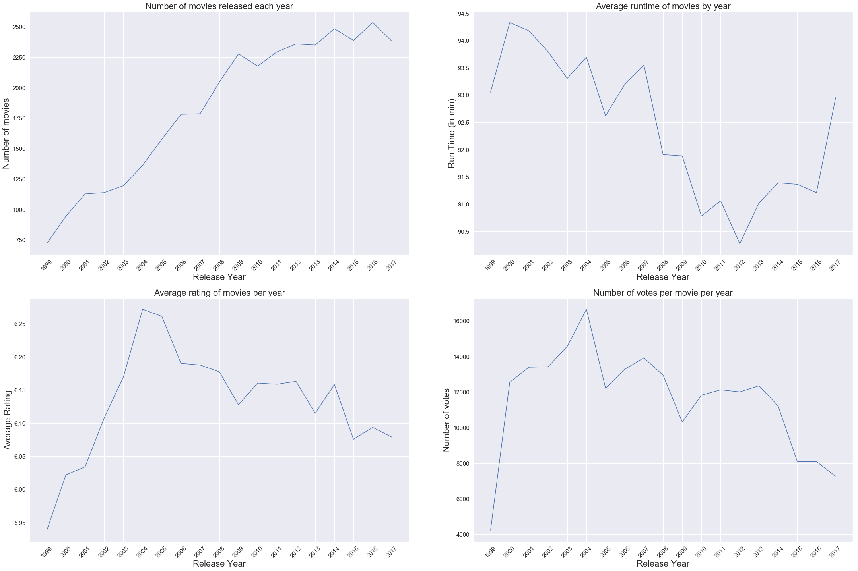
Considering movies released after 1999…

Slide 11
The spike of 2004
Eternal Sunshine of the Spotless Mind
Million Dollar Baby
Hotel Rwanda
Kill Bill (Vol. 2)
The Notebook
Harry Potter and the Prisoner of Azkaban
and the list goes on…

Slide 12
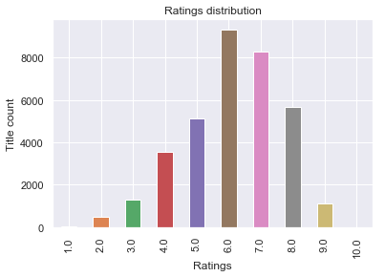
Plot of Ratings
Observations:
Avg rating around 6
Normally distributed

Slide 13
A Peek into the Features…

Slide 14
Movie Runtime
Maximum runtime: 51420 minutes or 857 hrs
Typical runtime of movies: 70-210 minutes*
Reasonable maximum runtime considered: 240 minutes
*(Source: https://en.wikipedia.org/wiki/Feature_film )

Slide 15
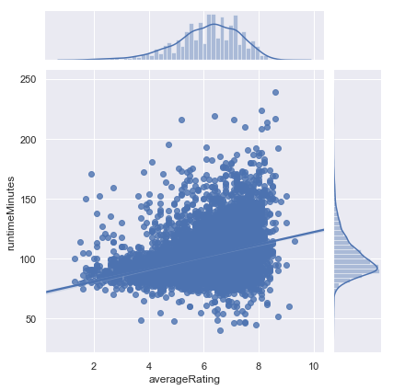
contd. Movie Runtime
Observations
Length of movies
α
Movie Ratings
Average runtime:102 minutes
Runtime >175 minutes
higher ratings

Slide 16
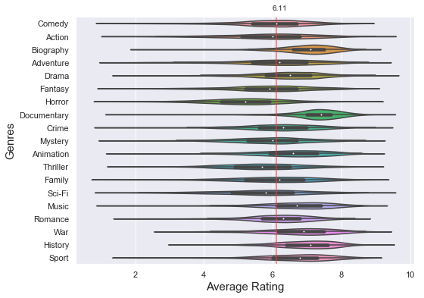
Movie Genre
Observations
Higher than average rating - history, biography, war, documentary
Horror movies rated lower than average

Slide 17
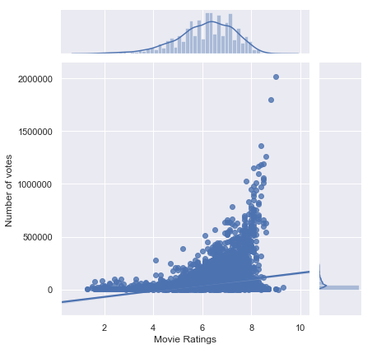
Number of Votes
>1000
Not a feature
Observations
Positive correlation
Higher vote count only for high rated movies

Slide 18
Feature Engineering

Slide 19
Genres
genres
Comedy,Fantasy,Romance
Action,Drama,Thriller
Comedy,Drama,Romance
Action,Comedy,Crime
Biography,Drama
genre_Thriller | genre_Western | genre_Comedy | ... | genre_Mystery | genre_Music
FALSE | FALSE | TRUE | ... | FALSE | FALSE
TRUE | FALSE | FALSE | ... | FALSE | FALSE
FALSE | FALSE | TRUE | ... | FALSE | FALSE
FALSE | FALSE | TRUE | ... | FALSE | FALSE
FALSE | FALSE | FALSE | ... | FALSE | FALSE
22 columns

Slide 20
Count of Cast & Crew
averageRating | nconst | category | primaryName
6.4 | nm0107463 | editor | David Brenner
6.4 | nm0000212 | actress | Meg Ryan
6.4 | nm0413168 | actor | Hugh Jackman
6.4 | nm0000630 | actor | Liev Schreiber
6.4 | nm0005227 | actor | Breckin Meyer
Unmelt
tconst | actor | actress | cinematographer | composer
tt0035423 | nm0413168,nm0000630 | nm0000212 | nm0238698 | nm0448843
tt0111068 | nm0474774,nm0709359,nm0694986 | nm0006689 | NaN | nm1269729
tt0168501 | nm0004875,nm0004820,nm0674782 | nm0000505 | nm0697910 | nm0006010
tt0168504 | nm0007045 | NaN | nm0003394 | nm0443867
tt0168786 | nm0000243,nm1035682,nm1287636 | nm0117146 | nm0003542 | nm0002217
tconst | count_actor | count_actress | count_cinematographer | cast_total | crew_total | actor_ratio
tt0035423 | 2 | 1 | 1 | 4 | 6 | 2
tt0111068 | 3 | 1 | 0 | 4 | 6 | 3
tt0168501 | 3 | 1 | 1 | 4 | 6 | 3
tt0168504 | 1 | 0 | 1 | 4 | 6 | 0

Slide 21
Cast & Crew Ratings
tconst | averageRating | actor | director | writer | crew
tt0035423 | 6.4 | 6.333333 | 7.2 | 6.7 | 6.7
tt0111068 | 7.1 | 6.466667 | 7 | 6.1 | 6.6
tt0168501 | 6.7 | 6 | 5.9 | NaN | 6.3
tt0168504 | 5.7 | 5.4 | NaN | NaN | 6.2
tt0168786 | 7.3 | 6.65 | NaN | 6.7 | 6.5
Cast/crew ratings = mean of movies they worked in
Category rating = mean of rating of all elements
Single movie cast/crew rating = NaN

Slide 22
Impact of a cast/crew on ratings
nm0490375 | nm0725808 | nm0727235 | nm0000219 | nm0833173
FALSE | FALSE | FALSE | FALSE | FALSE
FALSE | FALSE | FALSE | FALSE | FALSE
FALSE | FALSE | FALSE | FALSE | FALSE
FALSE | FALSE | FALSE | FALSE | FALSE
FALSE | FALSE | FALSE | FALSE | FALSE
Bottom rated movies
(Rating<=4
10 most frequent cast/crew
10 most frequent cast/crew
Top rated movies (Rating>=8)
20 new features

Slide 23
Heatmaps

Slide 24
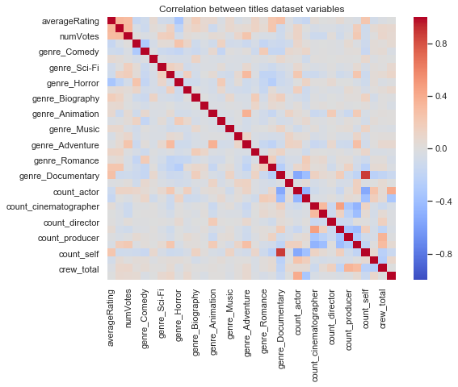
Avg Rating/Genre/Cast Crew Count
Observations
Positive correlation with ratings
Runtime minutes
Genre-documentary
Genre-drama
Count of ‘self’
Negative correlation with rating
Genre-horror
Number of actors
Number of actress

Slide 25
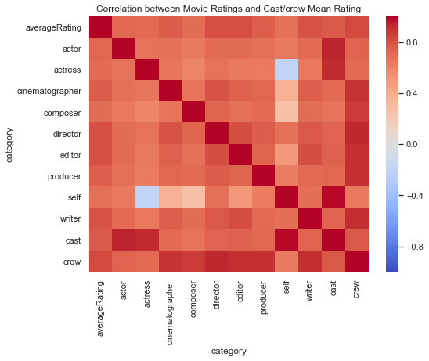
Cast/Crew Mean Ratings
Observations
All features highly correlated
Reason?

Slide 26
Machine Learning Modeling
https://github.com/koshika15/Predict-IMDB-rating-of-upcoming-movies/

Slide 27
Final Dataset
Target Variable
63 feature variables
Rating
8540 observations

Slide 28
Target Variable
Ranges from 1 (lowest rating) to 10 (highest rating)
Type of algorithm: Regression
Train-Test Split
Train:Test :: 70:30

Slide 29
Algorithms Used
1. Linear Regression
2. Regularization Model - Ridge
3. Regularization Model - Lasso
4. Ensemble Model - Random Forest
5. Ensemble Model - Gradient Boost
6. Ensemble Model - Ada Boost
7. Stack - Linear Regression
8. Stack - Random Forest
9. Stack - Gradient Boost

Slide 30
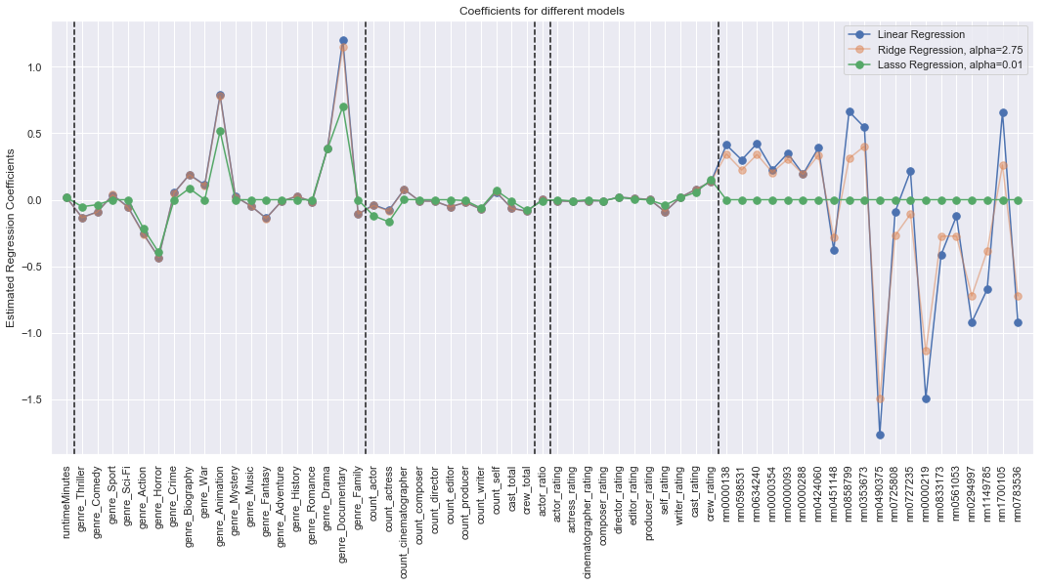
Coefficients of Linear regression and regularization models

Slide 31
Performance Evaluation
Root Mean Square Error
Time taken to fit and predict the model

Slide 32
Model Comparison
Modelling Algorithm | Train RMSE | Test RMSE | Hyperparameters | Training+Test Time(sec)
Linear Regression | 0.88972 | 0.903349 |  | 0.214
Ridge Regression | 0.890131 | 0.902272 | {'alpha': 2.75} | 5.414
Lasso Regression | 0.913179 | 0.919122 | {'alpha': 0.01} | 59.968
Random Forest | 0.30085 | 0.630694 | {'n_estimators': 5000, 'min_samples_split': 10... | 662.8
Gradient Boost | 0.3242 | 0.624689 | {'n_estimators': 500, 'min_samples_split': 2, ... | 89.796
Ada Boost | 0.691293 | 0.694207 | {'n_estimators': 300, 'learning_rate': 0.05} | 53.94
Stacking LR | 0.192679 | 0.650138 |  | 872.194
Stacking RF | 0.111337 | 0.643452 | {'n_estimators': 5000, 'min_samples_split': 5,... | 1012.3
Stacking GB | 0.089379 | 0.64748 | {'n_estimators': 250, 'min_samples_split': 10,... | 2082.43

Slide 33
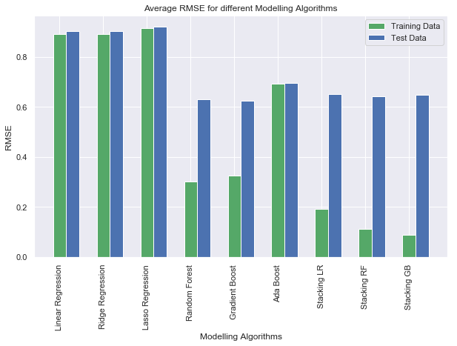
Conclusion

Slide 34
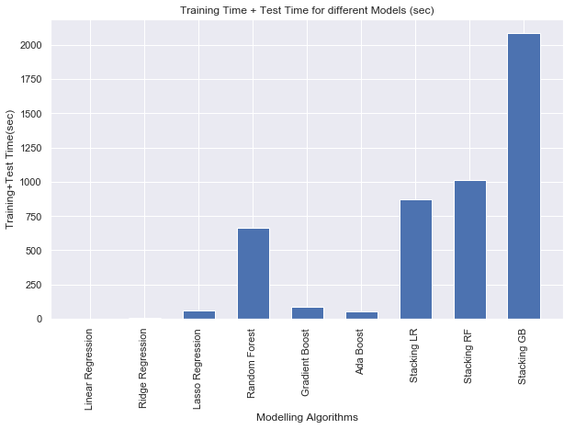
…contd Conclusion

Slide 35
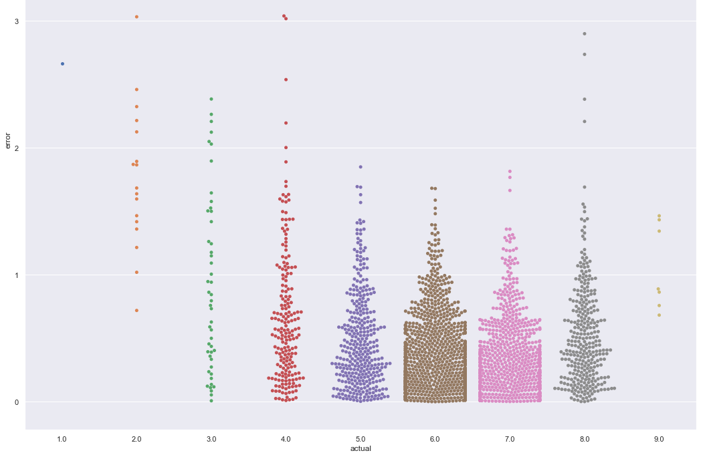
Result
Best model: Gradient Boost Model
RMSE: 0.625
Training + Test time: 90 seconds

Slide 36
Scope of further study
Combine box office predictions
Release month
Further work to be undertaken
Repeat machine learning process with different feature combinations
Explore other linear relationship assumptions between target and feature variables

Slide 37
Thank you!

Slide 38
Methodology
Hyperparameter Tuning
Fit
Predict
Training Data
Evaluate
Test Data

Slide 39
Process
HT
HT
HT
HT
HT
LR
Ridge
Lasso
Random Forest
Gradient Boost
ADA Boost

